Slide 1
Science Camp
May 20-22, 2019
Chapel Rock-Aspen Creek Outdoor School

Slide 2
Departure and Arrival
DEPART ASU Prep
Monday, May 20, 2019
6:45 am Arrive at ASU Prep STEM Academy
Bags and bedding labeled
Carry on, pillow, a blanket that fits inside of pillowcase
Refillable water bottle, carry on or packed in suitcase
Check in medications
We will provide snacks and G-Rated movies
ARRIVE – Back at ASU Prep
Wednesday, May 22, 2019
1:30 pm Arrive ASU Prep
Sign up for Remind 101 – and we will send you a text message when we are on the road.

Slide 3
Rules for Camp
Stay with your chaperone during classes.
Curfew is at 10:00 pm. All students/chaperones in their cabin.
Do not go anywhere at anytime without checking in first with your chaperone.
Girls in girls’ cabins.
Boys in boys’ cabins.
No electronics.
No cell phones.
All medications are with the nurse.
No knives or other weapons.
No water guns.
No food, candy, or gum in the cabins or outside during classes.
Stay within the camp boundaries.

Slide 4
Aspen Creek Outdoor Daily Schedule
Day 1 | Day 2 | Day 3
10:00-11:00 – Arrival & Orientation • Introduce staff teachers • Basic Rules/Expectations • Handout Notebooks 11:30-12:00 Orientation to Dining Hall and Lunch 12:00 – 12:30 Move-in to cabins 12:30-5:00 Announcements and Activities 5:00-5:30 – Dinner 5:30-7:00 – Free Time 7:00-8:30 – Evening Activity 8:30-10:00– Prepare for bed 10:00 – Lights Out | 7:00 – Rise and Shine! 7:30-8:00 – Breakfast 8:00-8:30 – Free Time 8:30-11:30 – Announcements + Activities! 11:30-12:00 – Lunch 12:00-12:30 – Free Time 12:30-5:00 – Announcements + Activities! 5:00-5:30 – Dinner 5:30-7:00 – Free Time 7:00-8:30 – Evening Activity 8:30-10:00 – Clean-up Prepare for bed 10:00 – Lights Out | 7:00 – Rise and Shine! 7:30-8:00 – Breakfast 8:00-9:00 – Pack up bags, clean and bring to bags bus depot 9:00-9:15 – Cabin Check, 9:30 – Big Group Picture (Meet at Horseshoe) 9:30-11:00 – Final Group Activity 11:00am Departure 1:30 pm Arrival Time ASU Prep STEM Academy *We will send a notice VIA Remind 101 – Please Sign up

Slide 5
Meals
Food and Meals Breakfast, lunch, and dinner are served in our dining hall. Our well balanced, kid-friendly meals are planned and prepared daily by our head chef, Tom Farley, and his experienced food service staff.
With vegetarian, gluten-free, and dairy-free options, we are happy to accommodate for any special dietary restrictions or allergies. We just ask that you please give us your requests in advance.
Dining Hall Rules!
Please talk only with the folks at your table (to keep the noise level down).
Please take only what you will eat and make sure there is enough for everyone.
Please be polite by staying quiet during announcements before and after the meals.
Students are responsible for clearing their own tables and one cabin group per meal will be assigned dining hall wipe-down duty.
A typical day's meals at Chapel Rock may look something like this:

Slide 6
Sample Daily Menu
Breakfast | French Toast Scrambled eggs Hash Browns Sweet Bread Fresh fruit, yogurt & granola bar Oatmeal
Lunch | Grilled Cheese Tater Tots Salad & Fruit Bar Dessert
Dinner | Pasta Bar Meatballs and Marinara Cooked Vegetable Bread, Rolls & butter Salad & Fruit bar Dessert
Drinks | Fountain Drinks, Juice, water, Hot Chocolate, Tea, Coffee

Slide 7
Packing List
one medium size suitcase or duffel bag 13 X 24 X 12
a sleeping bag or bed roll (Please label all suitcases/duffel bags/garbage bag).
Please pack only the things on the list.
Label all your child's belongings. A laundry marker can be used on clothes.
Students will not need money.
Please pack a plastic bag for packing wet and/or dirty clothing on the return trip.
Please check appropriateness of what your child has packed. Remember that layers of clothing are warmer and can be removed if needed. Pack for all kinds of weather...warm, cold, or wet. Be sure your child has selected clothes that are designed to get dirty.
Students are responsible for all their belongings for their return trip home.
Bring sun block and a hat during warmer months
Long pants and a jacket

Slide 8
Yes, You May and No, You May Not
You May Bring:
Camera and film, pen, pencil and notebook, good book for reading
Please Do NOT Bring:
Radio
tape player
IPod
video game
cell phone
expensive jewelry
knives
Food, candy, or gum

Slide 9
Electronics
No electronics
If you want your child to bring a phone, Mrs. Biggs will keep the phone at the teacher cabin. Each phone will be in a labeled bag and will be kept turned off. Your child will have full access to use the phone whenever they need to call home.
Chaperones and teachers will take photos and share photos with families.
If you do not want your child photographed, please let Mrs. Biggs or Mrs. Obert know ASAP.

Slide 10
Medications and Allergies
Every child needs a “Parent Consent for Giving Medication” form signed and returned tonight
Friday, May 17th – before school and after school you can drop off medication with the camp nurse in the 5th grade quad area.
All medications stay with the camp nurse
Only enough medication for days at camp
Original bottle or a copy of the original bottle
EPI pens with instructions (Permission to carry?)
Inhalers with instructions (Permission to carry?)
DO NOT DROP OFF medications with Miss G!
The camp nurses will call you with questions, concerns, and updates
No drops or essential oils

Slide 11
Paperwork
Chapel Rock Participant Form
Chaperones need one
Students need one
ASU Prep STEM Academy Permission slip
Parent Consent for Giving Medication

Slide 12
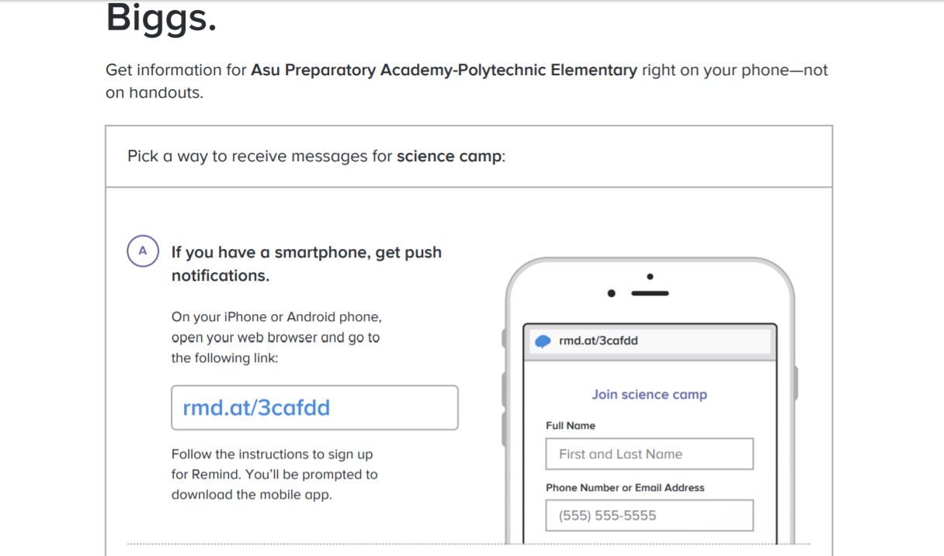
Remind 101

Slide 13
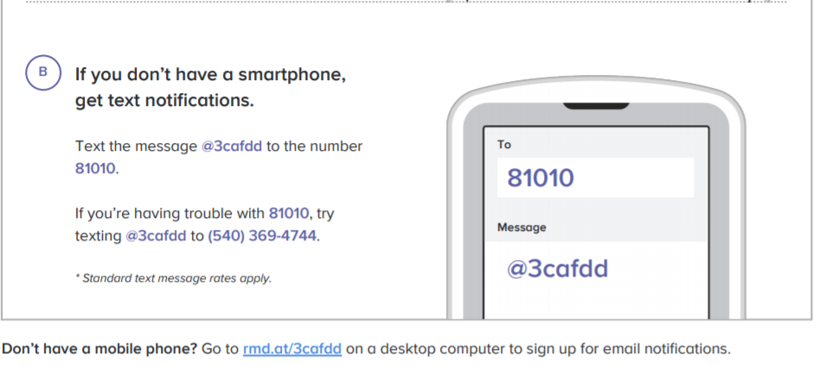
Remind 101 – Not using a smartphone

Slide 14
Chapel Rock Contact Info
Chapel Rock
928-445-3499
1131 Country Club Dr.
Prescott, AZ
86303
http://www.chapelrock.net/aspen/index.htm

